Slide 1




ADS
TRACK
Understanding the Ranking Loss for Recommendation with Sparse User Feedback
Zhutian Lin*, Junwei Pan*, Shangyu Zhang, Ximei Wang,
Xi Xiao, Shudong Huang, Lei Xiao, Jie Jiang
Tsinghua University, Tencent Inc.

Slide 2
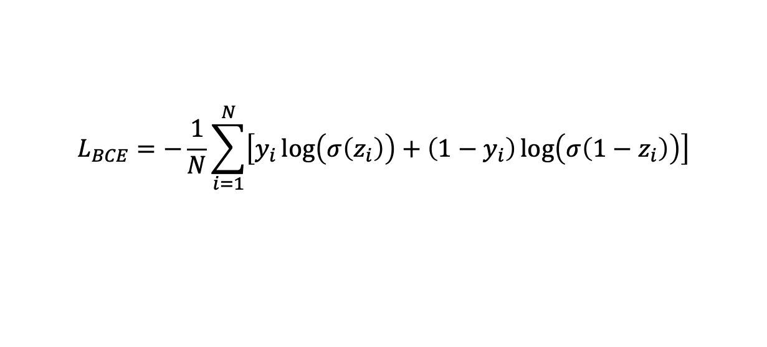
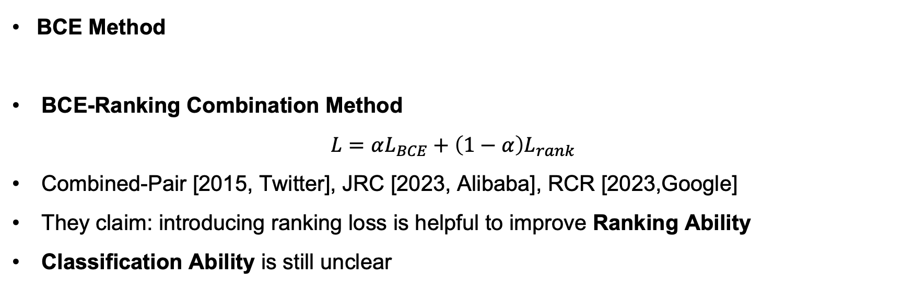
CTR Prediction: Binary Classification
$$L_{BCE}=−\frac{1}{N}\sum_{i=1}^{N}{\left[y_{i}\log\left(σ\left(z_{i}\right)\right)+\left(1−y_{i}\right)\log\left(σ\left(1−z_{i}\right)\right)\right]}$$
BCE Method
BCE-Ranking Combination Method
$$L=αL_{BCE}+\left(1−α\right)L_{rank}$$
Combined-Pair [2015, Twitter], JRC [2023, Alibaba], RCR [2023,Google]
They claim: introducing ranking loss is helpful to improve Ranking Ability
Classification Ability is still unclear
Notes:
CTR prediction, which is one of the most critical task in ads recommendation, is usually formulated as a binary classification problem, optimized by a binary-cross entropy loss.
Recently, there is a trend in combining BCE loss with ranking loss, and there are several papers from industry, such as Twitter, Abibaba and Google.
They claim that introducing auxiliary ranking loss helps to improve the ranking ability of the model, which is obvious.
However, there is no research on the impact on the classification ability. And this is the main focus of our paper.

Slide 3
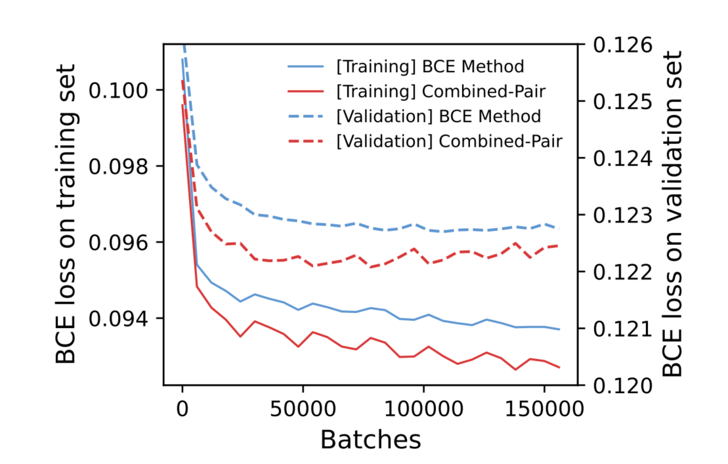
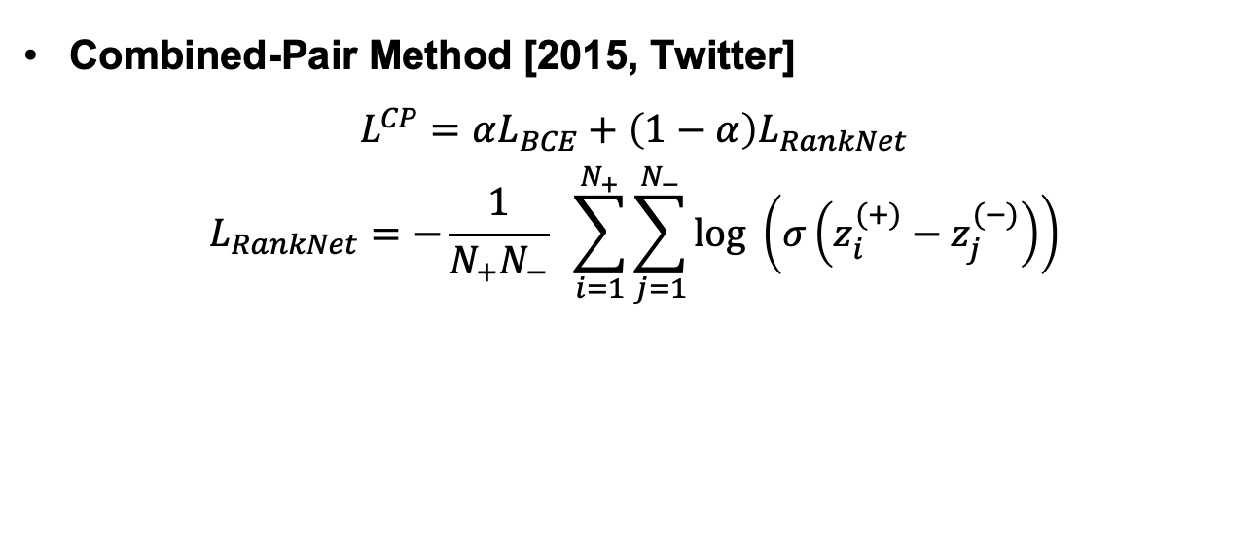
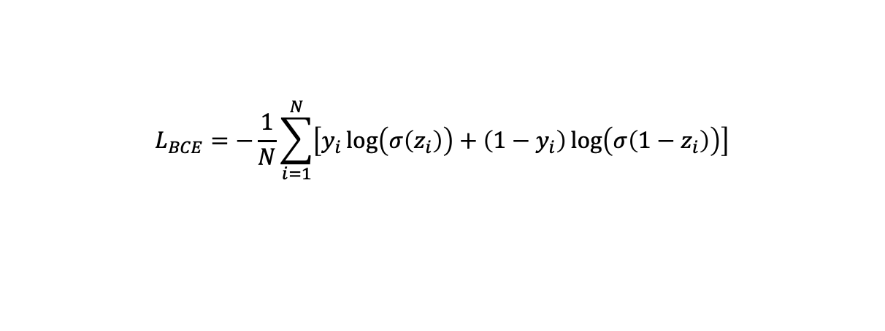
Classification Ability
BCE Method
$$L_{BCE}=−\frac{1}{N}\sum_{i=1}^{N}{\left[y_{i}\log\left(σ\left(z_{i}\right)\right)+\left(1−y_{i}\right)\log\left(σ\left(1−z_{i}\right)\right)\right]}$$
Combined-Pair Method [2015, Twitter]
$$L^{CP}=αL_{BCE}+\left(1−α\right)L_{RankNet}$$
$$L_{RankNet}=−\frac{1}{N_{+}N_{−}} \sum_{i=1}^{N_{+}}{\sum_{j=1}^{N_{−}}{log \left(σ\left(z_{i}^{(+)}−z_{j}^{(−)}\right)\right)}}$$
Can Combined-Pair gain better classification ability?
Finding 1. Combined-Pair gets a lower BCE loss than the BCE method on the validation set, indicating that it improves the classification ability rather than only the ranking ability.
Notes:
Here we study a representative model with BCE-ranking combination loss: the Combined-Pair, which combines the BCE loss with a RankNet loss.
We train a model with only BCE loss, namely the BCE method, and the Combined-Pair. And we compare the BCE loss of these two methods on the validation set.
Surprisingly, we have the following interesting finding:
Combined-Pair gets a lower BCE loss than the BCE method on the validation set, indicating that it improves the classification ability rather than only the ranking ability.

Slide 4
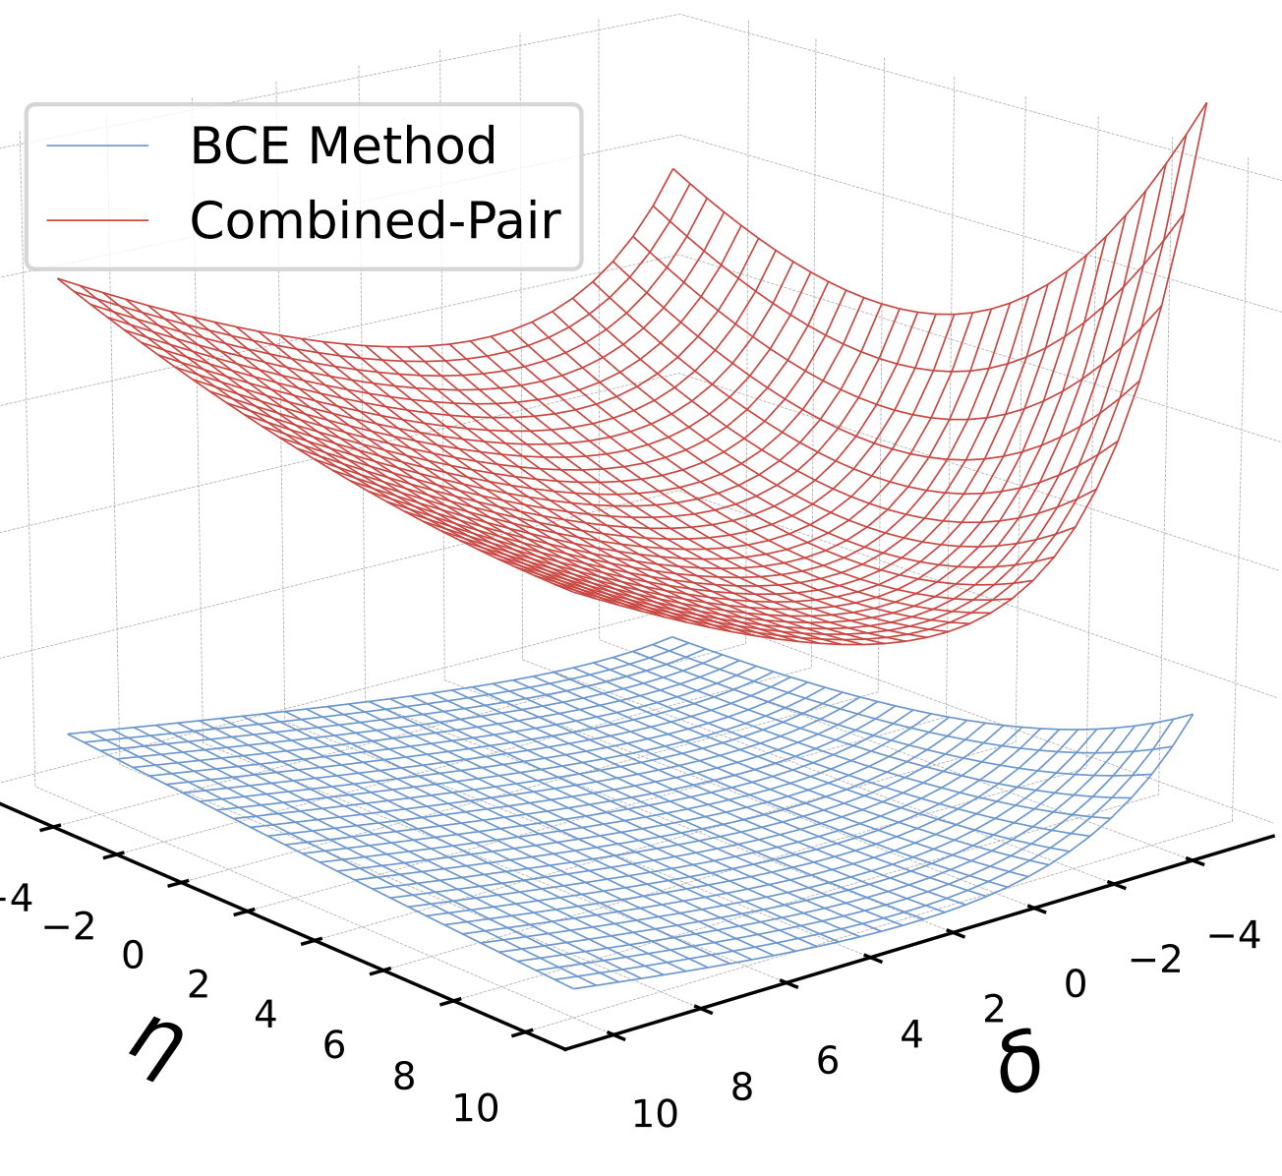
Optimization
Finding 1. Combined-Pair gets a lower BCE loss than the BCE method on the validation set, indicating that it improves the classification ability rather than only the ranking ability.
Better generalization or better optimization?
Finding 2. Combined-Pair gets a lower BCE loss than the BCE method on the training set, indicating that involving an auxiliary ranking loss helps the optimization of the BCE loss.
What is the optimization issue of BCE method?
The BCE method has a flat loss landscape, indicating optimization.
Notes:
We are curious why this happen. That is, if this is due to better generalization on the validation loss? Or better optimization on the training set.
We then analyze the BCE loss of these two methods on the training set, and have a more interesting observation:
Combined-Pair gets a lower BCE loss than the BCE method on the training set, indicating that involving an auxiliary ranking loss helps the optimization of the BCE loss.
This phenomenon makes us wonder what’s the optimization issue of the BCE method.
We plot the loss landscape of these two methods, as shown in the right, we found that the loss landscape of BCE methods is quite flat, while the landscape of the Combined-Pair is much steeper.

Slide 5
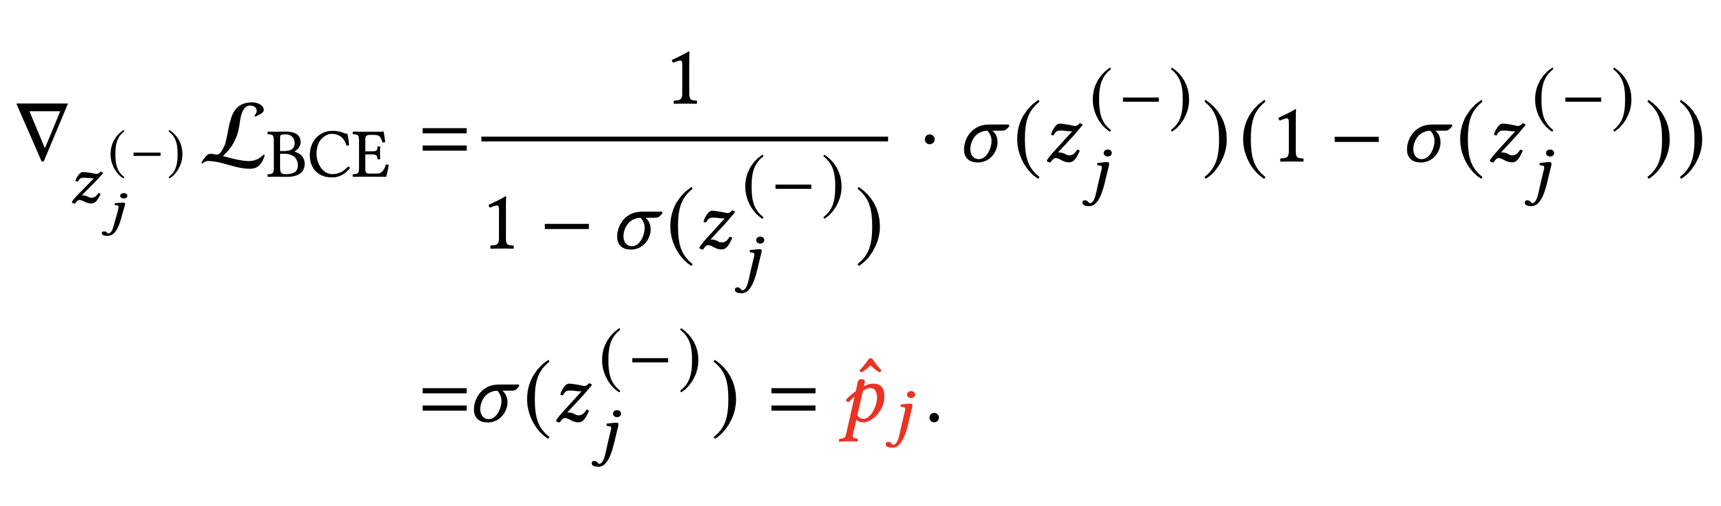
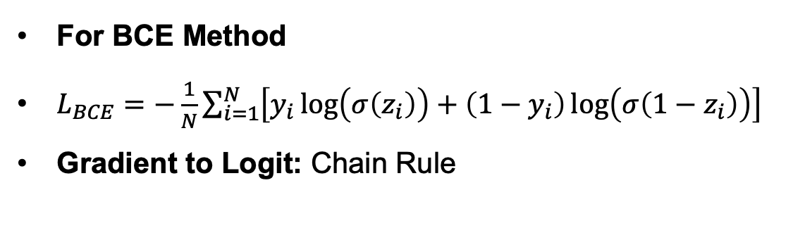
Gradient Analysis of BCE method
For BCE Method
$L_{BCE}=−\frac{1}{N}\sum_{i=1}^{N}{\left[y_{i}\log\left(σ\left(z_{i}\right)\right)+\left(1−y_{i}\right)\log\left(σ\left(1−z_{i}\right)\right)\right]}$
Gradient to Logit: Chain Rule
Finding 3. When positive feedback is sparse, the gradients of negative samples vanish since they are proportional to the estimated scores, which are small in an unbiased estimator.
Negative Samples
An uncovered challenge
Gradient vanishing of negative samples under sparse positive feedback.
Proportional to the estimated score.
Estimated score is low in scenarios with sparse positive feedback.
Notes:
Observing the flat loss landscape of the BCE method, we then analyze the gradient of the each method.
We start with the BCE method, which only has a BCE loss.
After simple derivation, we found that the partial gradient of BCE loss to the logit is proportional to the prediction score.
In CTR prediction, there is usually much less positive samples than negative samples, so the pCTR is usually low.
Hence, we conclude with the following finding:
When positive feedback is sparse, the gradients of negative samples vanish since they are proportional to the estimated positive rates, which are small in an unbiased estimator.
We refer to this as gradient vanishing of negative samples under sparse positive feedback.

Slide 6
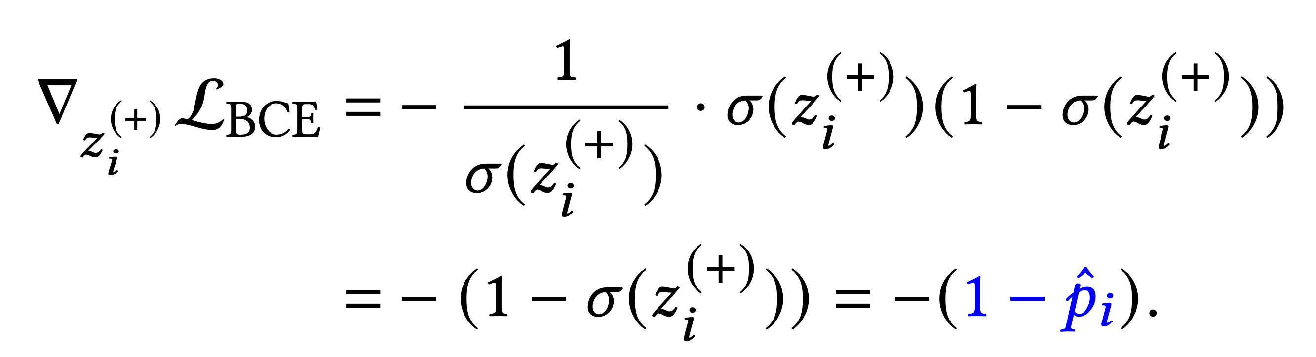
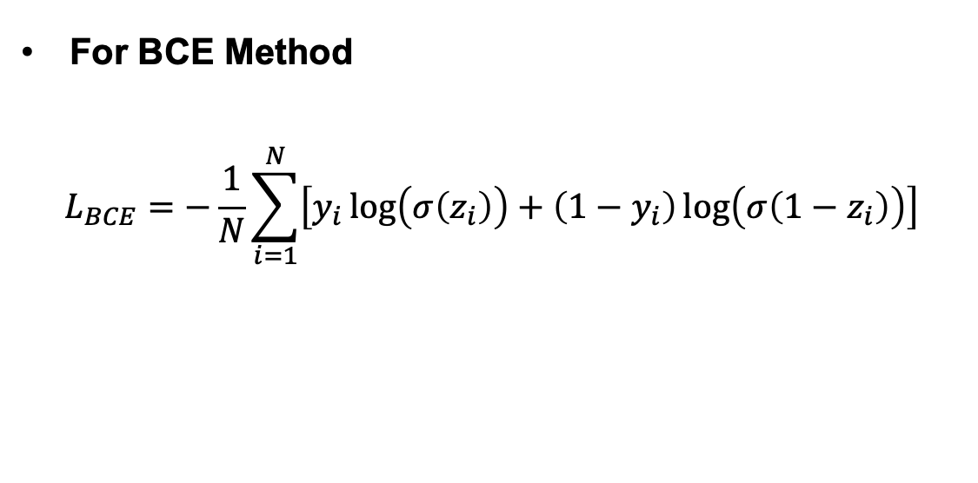
Gradient Analysis of the BCE method
For BCE Method
$$L_{BCE}=−\frac{1}{N}\sum_{i=1}^{N}{\left[y_{i}\log\left(σ\left(z_{i}\right)\right)+\left(1−y_{i}\right)\log\left(σ\left(1−z_{i}\right)\right)\right]}$$
Positive Samples
Proportional to (1-pCTR)
Notes:
Then we also analyze the gradients of positive samples.
We found that their gradients are proportional to the 1-pCTR, which is a quite large value since pCTR is low.
Therefore, positive samples don’t suffer from gradient vanishing as negative samples do.

Slide 7
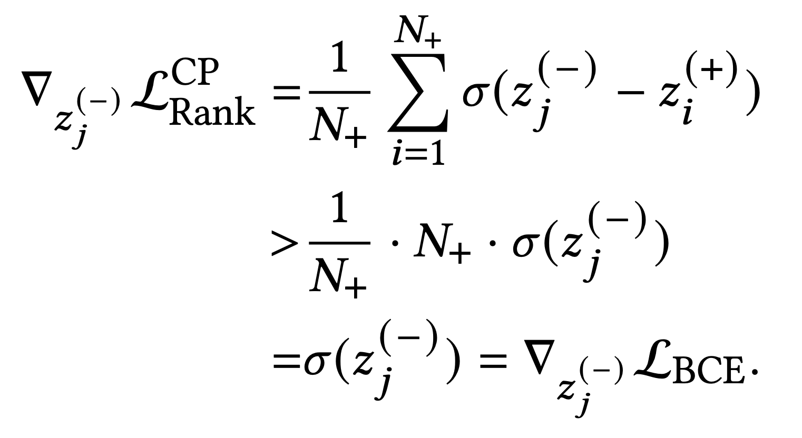
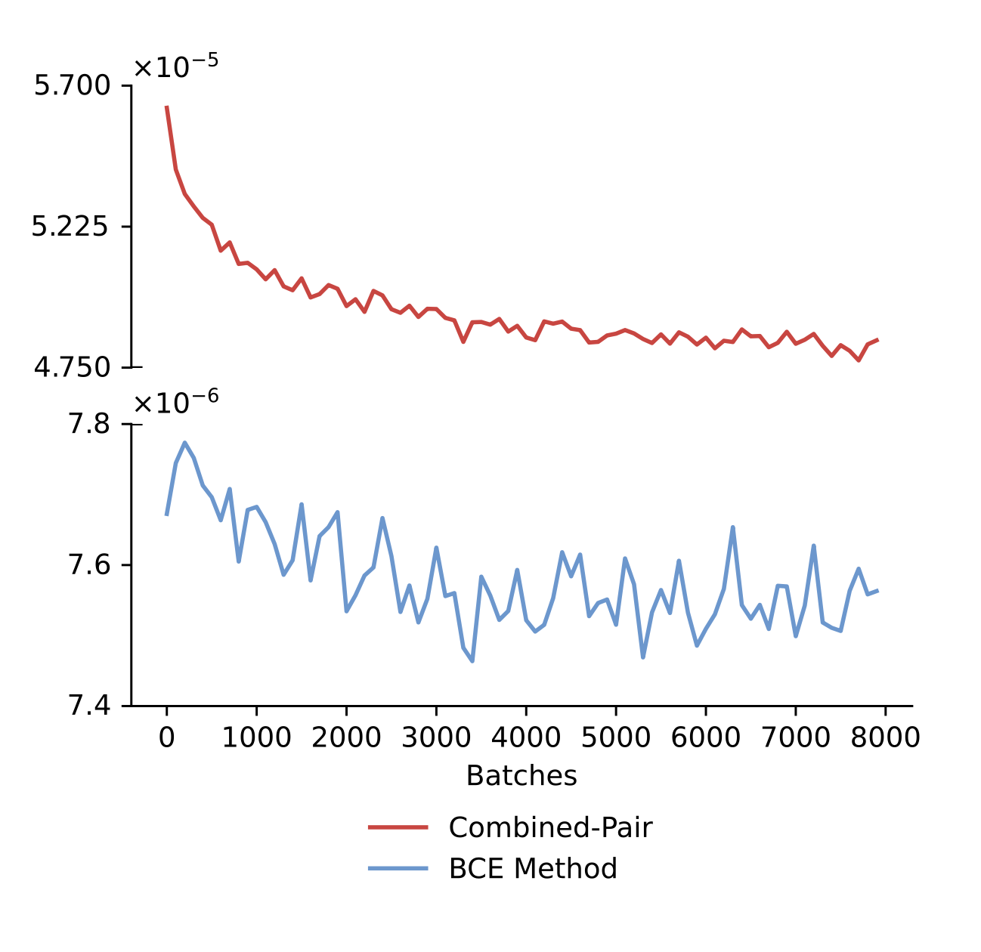
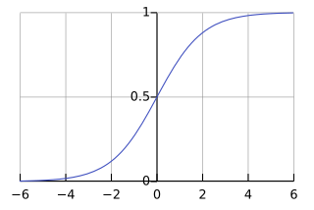
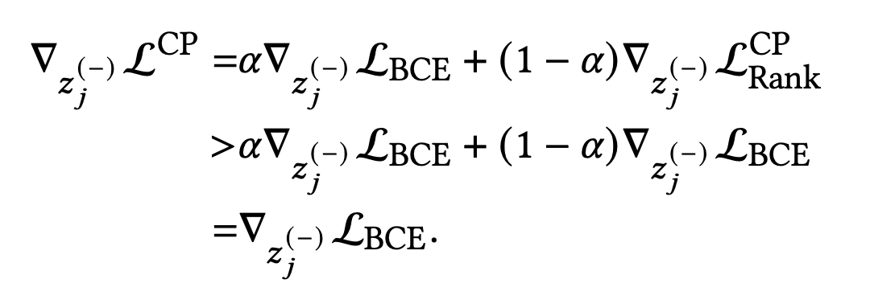
Gradient Analysis of Combined-Pair
For Combined-Pair
Gradients Norm
Usually a negative value
Finding 4. When positive feedback is sparse, Combined-Pair has larger gradients for negative samples than the BCE method.
[1] Le Yan,Zhen Qin,Xuanhui Wang,Michael Bendersky,andMarc Najork.2022. Scale calibration of deep ranking models. In Proceedings of the 28th ACM SIGKDD Conference on Knowledge Discovery and Data Mining. 4300–4309.
Notes:
We then analyze the gradients of negative samples in the Combined-Pair loss.
We found that the negative sample gradients are proportional to sigma(z^- - z^+).
It’s large than sigma(z^-) since z^+ is usually a negative value since the prediction score should be less than 0.5 in CTR scenarios.
We conclude with the following finding:
When positive feedback is sparse, Combined-Pair has larger gradients for negative samples than the BCE method.

Slide 8
Findings so far
Finding 1. Combined-Pair gets a lower BCE loss than the BCE method on the validation set, indicating that it improves the classification ability rather than only the ranking ability. x
Observation
Combined-Pair gets lower BCE loss on validation and training set.
Finding 2. Combined-Pair gets a lower BCE loss than the BCE method on the training set, indicating that involving an auxiliary ranking loss helps the optimization of the BCE loss.
Finding 3. When positive feedback is sparse, the gradients of negative samples vanish since they are proportional to the estimated positive rates, which are small in an unbiased estimator.
Perspective
BCE method suffer from the gradient vanishing of negative samples, while Combined-Pair mitigate this with larger gradients.
Finding 4. When positive feedback is sparse, Combined-Pair has larger gradients for negative samples than the BCE method.
Notes:
We then analyze the gradients of negative samples in the Combined-Pair loss.
We found that the negative sample gradients are proportional to sigma(z^- - z^+).
It’s large than sigma(z^-) since z^+ is usually a negative value since the prediction score should be less than 0.5 in CTR scenarios.
We conclude with the following finding:
When positive feedback is sparse, Combined-Pair has larger gradients for negative samples than the BCE method.

Slide 9
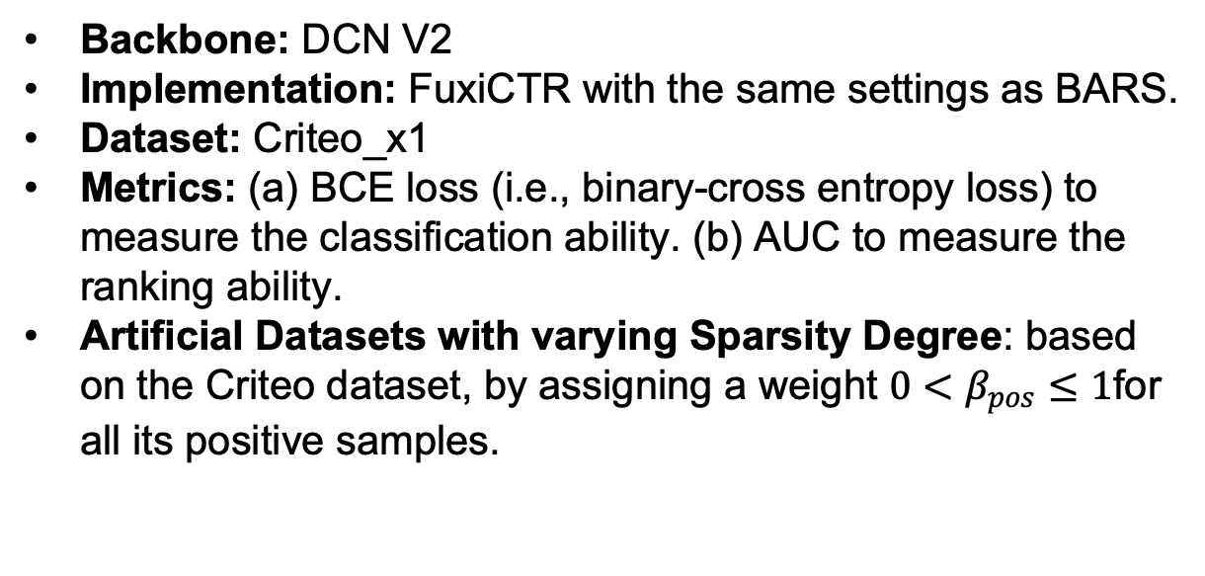
Experimental Analysis
Setting
Backbone: DCN V2
Implementation: FuxiCTR with the same settings as BARS.
Dataset: Criteo_x1
Metrics: (a) BCE loss (i.e., binary-cross entropy loss) to measure the classification ability. (b) AUC to measure the ranking ability.
Artificial Datasets with varying Sparsity Degree: based on the Criteo dataset, by assigning a weight $0<β_{pos}≤1$for all its positive samples.
1 https://github.com/reczoo/Datasets/tree/main/Criteo/Criteo_x1 2 https://github.com/reczoo/FuxiCTR/tree/main/model_zoo/DCNv2 3 https://github.com/reczoo/BARS/tree/main/ranking/ctr/DCNv2/DCNv2_criteo_x1
Notes:
Next we’re going to discuss our experiment details.
We are using DCN V2 as the backbone model implemented in FuxiCTR, with the same seting as BARS.
We choose the Criteo x1 dataset.
Please note that the Criteo dataset is down sampled with its negative samples, so the CTR of this dataset is not low, which is different from the real-world scenario.
To recover the sparse positive scenario, we assign a weight for all positive samples in the loss.
We set the weight value less than 1 to simulate the real-world sparse positive feedback scenario.

Slide 10
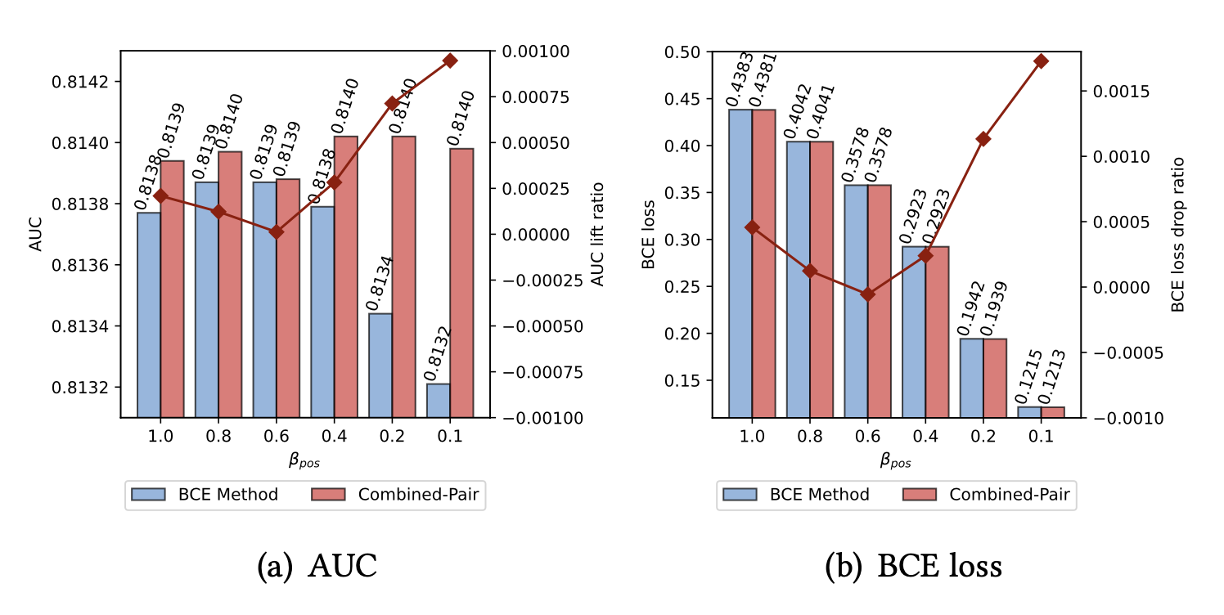
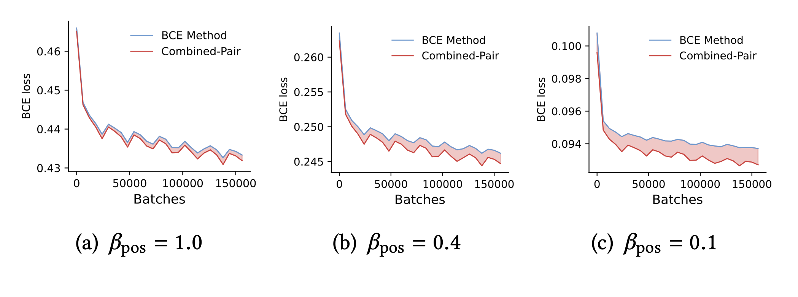

RQ1: Performance Evaluation with various Positive Sparsity Rates
Training BCE Loss
Test AUC & BCE Loss
A smaller $β_{pos}$indicates sparser positive feedback.
When positives becomes more sparse by reducing the $β_{pos}$, the more severe of gradient vanishing issue of negative samples:
Notes:
First of all, we can tune the positive sparsity rates by tuning the weight beta. The lower value of beta, the sparse of positive samples.
We have the following observation:
When positives becomes more sparse by reducing the $β_{pos} ,$ the more severe of gradient vanishing issue of negative samples:
larger train BCE loss reduction of Combined-Pair vs BCE method, the larger AUC lift and BCE loss drop after certain threshold of $β_{pos}=0.4$.
This validates our hypothesis that introducing the auxiliary ranking loss mainly mitigate the gradient vanishing issue when the positive feedback is sparse.

Slide 11
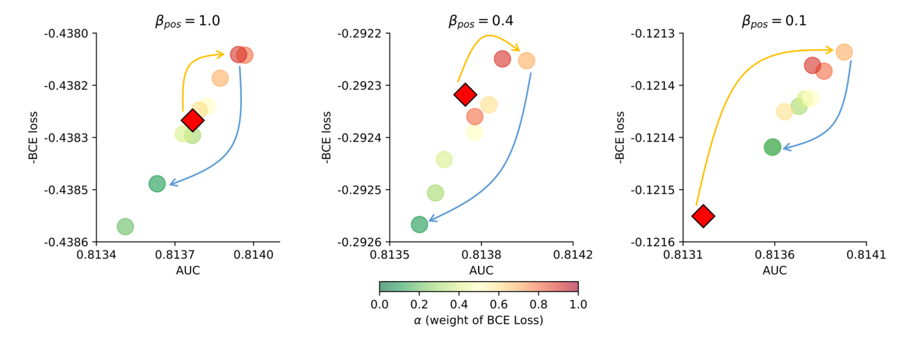
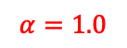
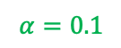

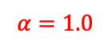
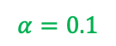
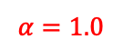
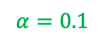
RQ2: Impact of Loss Weight
$$L=αL_{BCE}+\left(1−α\right)L_{rank}$$
The most sparse dataset
$$α=1.0$$
$$α=1.0$$
0.1 weight for BCE loss
0.9 weight for Ranking loss
$$α=0.1$$
$$α=0.1$$
$$α=1.0$$
$$α=0.1$$
Notes:
Here we study the impact of the loss weight alpha.
We tune the weight alpha, that is, the weight of the BCE loss, from 1 to 0.1. Each figure represent a dataset with different positive rates.
We can observe that, at the beginning when we decrease alpha from 1.0 to certain values such as 0.7 or 0.8, both BCE and AUC are improved.
This validates that : introducing ranking loss benefits both classification and ranking abilities!
However, when we further decrease alpha, both metrics are becoming worse.
One interesting observation is that, when the positives are very sparse, there is a similar trend, then both metrics are first improved, and then decreasing.
However, the end point, which with alpha equal to 0.1, is still getting better performance than BCE!

Slide 12
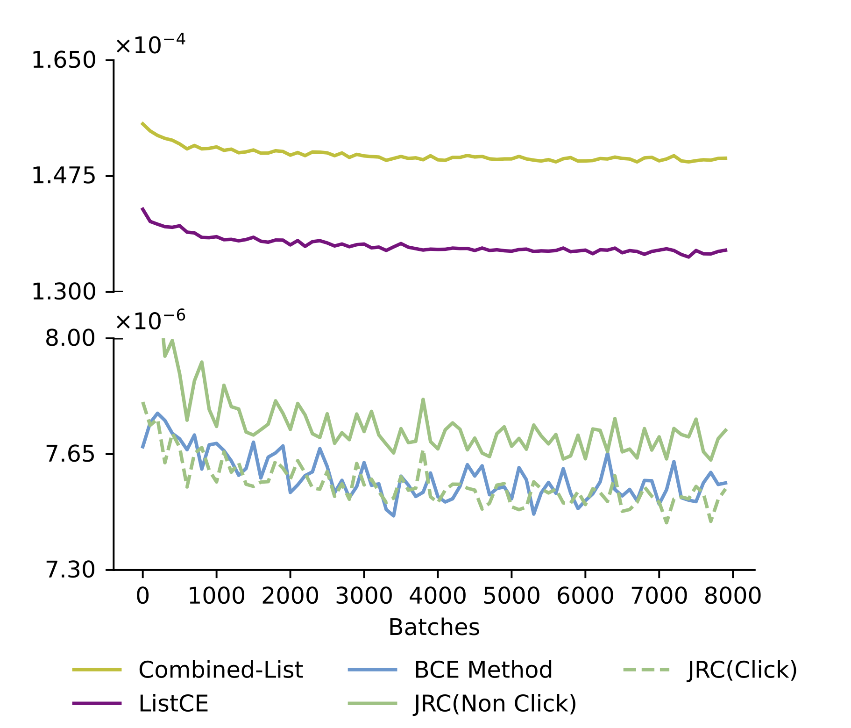
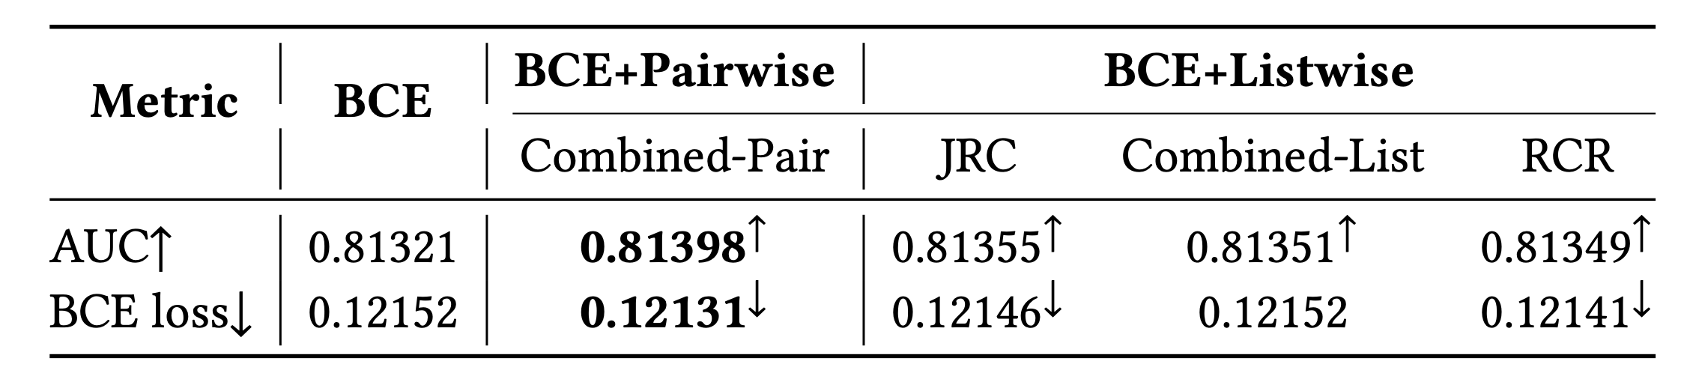

RQ3: Evaluation of Different Ranking Losses
$$L=αL_{BCE}+\left(1−α\right)L_{rank}$$
Observations:
All auxiliary ranking losses get:
Higher AUC
Lower BCE loss
Larger gradients on negative samples
Notes:
We also experiment many other ranking losses beside the RankNet.
All of them get better AUC, which means better ranking ability, and they get lower BCE loss, which means better

Slide 13
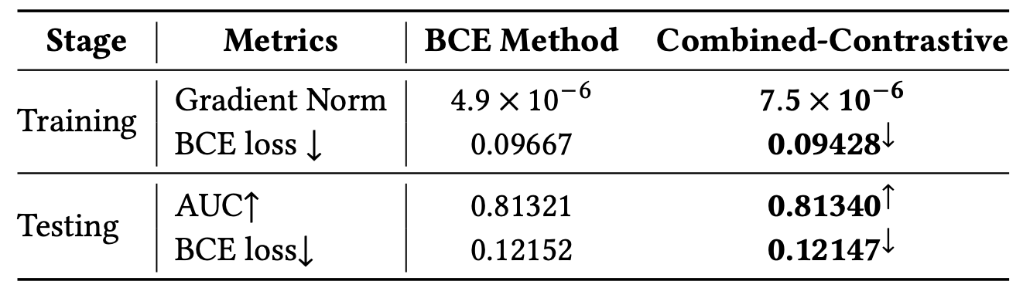
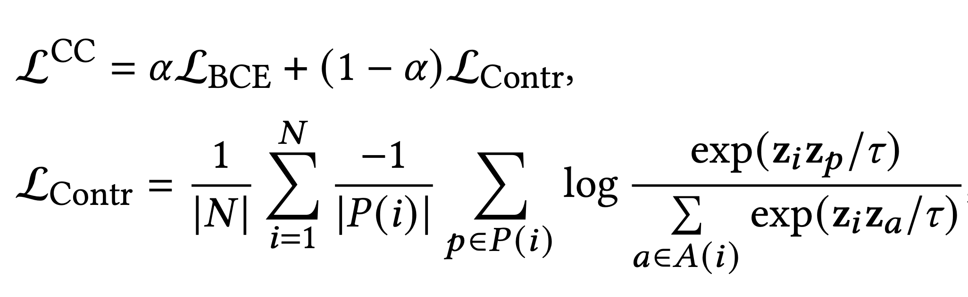
RQ4: Beyond Ranking Loss
New Method: Combined-Contrastive
Combine classification loss with contrastive loss
Notes:
We then go beyond ranking loss.
That is, if our explanation is true, then there should be other methods that can also tackle the challenge of gradient vanishing on negative samples.
To this end, we propose to add an auxiliary contrastive loss upon the existing BCE loss.
We do observe that:
On the testing data, it gets better AUC and BCE loss.
On the training, the BCE loss is also decreased
The gradient norm on negative samples are larger.
This validates that this method can also resolve the gradient vanishing challenge and improve the classification and ranking ability.

Slide 14
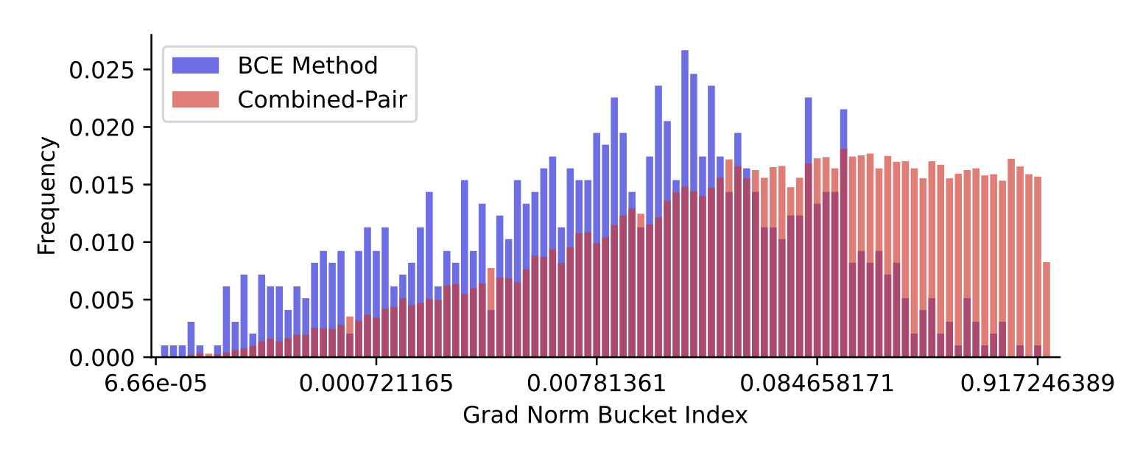
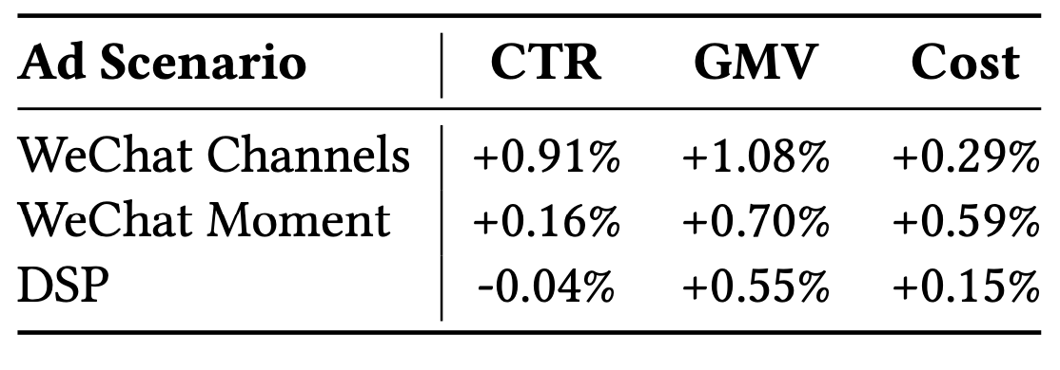
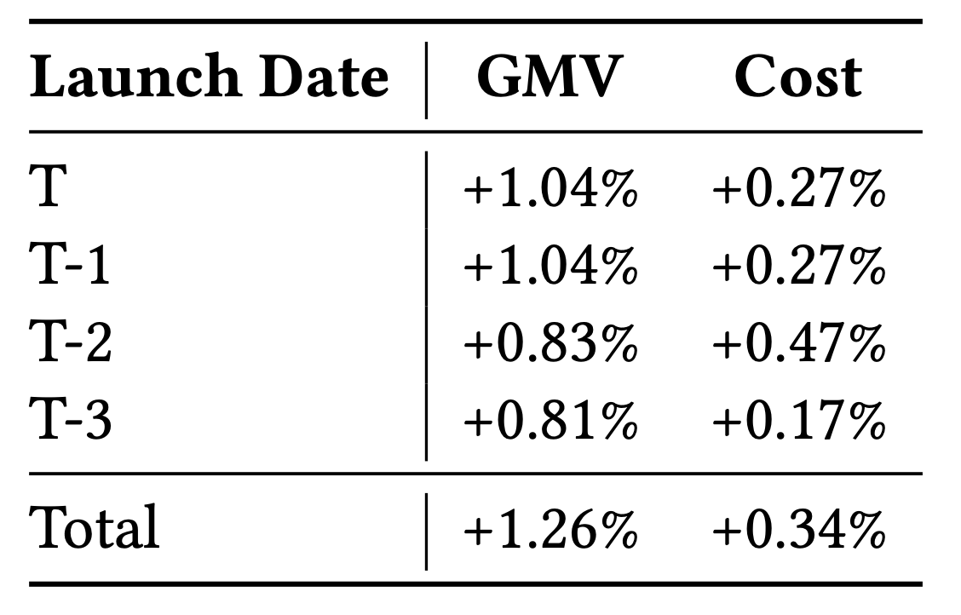
Online Deployment
Background:
Online A/B testing from early July 2023 to August 2023.
Streaming training with 𝛼 = 0.9.
The CTR varies from 0.1% to 2.0% in different scenarios.
A/ B Test Results :
Gradient Norm Distribution of Negative Samples:
Right skewed
More negative samples with larger gradient norm
New ads:
Notes:
We deploy Combined-Pair

Slide 15


Q & A
QR of Github repo

